Slide 1
Mobile Compliance 11-JUNE-2013
By,
Meghna Baijal
(Mentor: Pravin Goyal)

Slide 2

Agenda
Objectives
Events on Android
Events on iOS
GAP analysis on android
GAP analysis on iOS
MS Exchange for pushing app
Force Close on Android
Force Close on iOS
Questions

Slide 3

Some Questions to Answer
How to listen for Required events on android and iOS?
Events on iOS
GAP analysis on android
GAP analysis on iOS
MS Exchange for pushing app
Force Close on Android
Force Close on iOS
Questions

Slide 4
Event Driven Compliance

Slide 5

Event Driven Compliance - Android
What events drive the app currently ?
Network connection change ie connecting to or disconnecting from a current connection.
Installation of any app on the device
Removal of any app from the device.

Slide 6

Event Driven Compliance - iOS
What events drive the app currently ?
Only WiFi connection change

Slide 7
Event Driven Compliance - Android
Can any change in device configuration be an event ?
Yes, any setting that can be read can be made into an event.
How ?
There are custom notifications in android that can be created as required. We can continuously poll for a setting’s value and fire the intent as soon as the setting changes and create our own notification.
Downside ?
Here we would run into the problem of putting too much load on the server due to polling continuously.

Slide 8
Event Driven Compliance - iOS
Can any change in device configuration be an event ?
Yes, any setting that can be read can be made into an event.
How ?
You can create custom notifications. That is I can create a notification called ‘note1’ in my app and can define it as I want. Some other objects in my app can register to receive it and perform a task. This could help if we could create a notification that could capture change in settings. The only way I could think of doing that was to continuously poll to check a particular setting (say every sec) and then as soon as it changes, I could fire the notification and rerun the whole data collection Using this way we would probably be able to have an event for each setting we can read.
Downside ?
Again, we would run into the problem of putting too much load on the server due to polling continuously.
We read very few settings on iOS using the API in the first place.
Also, I am not sure how this would work in the background. As per what I read apps in the background are allowed to do some limited code execution and that too only for a while. I am not sure if continuous polling on so many settings would be allowed for an app in the background.

Slide 9
Event Driven Compliance - Android
What are the other default events that can be captured?
Package added
Package removed
Wifi state changed
Action power connected
Action power disconnected
Action shutdown
Airplane mode
Boot completed
Data sms received
Device storage low
Media mounted
Screen off
Screen on
Connection change
Sim full
Sms received
Done

Slide 10
Event Driven Compliance - iOS
What are the other default events that can be captured?
…..

Slide 11
Events
What can not be done
Event Driven Compliance on iOS:
App Install and app remove:
https://vmware-com.socialcast.com/messages/15762751

Slide 12
GAP Analysis

Slide 13
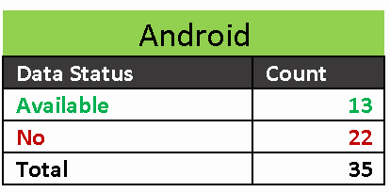
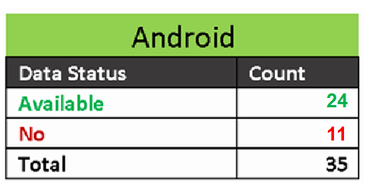
Gap Analysis
GAP Analysis for Android
a. Analysis using android API
b. MS Exchange + API

Slide 14
CIS Setting | Data Available | via exchange
1.1.1 Update 'firmware' to latest version | Yes
1.1.2 Enable 'Password' | partial | Yes
1.1.3 Enable 'Require alphanumeric value' | No | Yes
1.1.4 Set 'timeout in minutes' for 'Sleep' | Yes | Yes
1.1.5 Remove Entries in 'Wi-Fi' | No
1.1.6 Disable 'Network Notification' | Yes
1.1.7 Disable 'Wi-Fi' | Yes
1.1.8 Disable 'Bluetooth' | Yes
1.1.9 Disable 'Location Services' | Yes
1.1.10 Enable 'Airplane Mode' | Yes
1.1.11 Erase all data before return, recycle, reassignment, or other disposition | No | ? Same as wipe device?
1.1.12 Disable 'Notifications' | ??
1.1.13 Enable 'Lock SIM card' | No
1.1.14 Disable 'make passwords visible' | Yes
1.1.15 Enable 'Encrypt phone' | Yes | Yes
1.1.16 Disable 'developer options' | Yes
1.1.17 Disable 'Unknown sources' | Yes
1.1.18 Limit the 'number of messages' for 'Text message limit' | No
1.1.19 Limit the 'number of messages' for 'Multimedia message limit' | No
1.2.1 Disable 'JavaScript' | No
1.2.2 Enable 'Show security warnings' | No
1.2.3 Disable 'Form auto-fill' | No
1.2.4 Disable 'Accept Cookies' | No
1.2.5 Enable 'Block pop-ups' | No
1.2.6 Disable 'plug-ins' | No
1.2.7 Disable 'Remember passwords' | No
2.1.1 Enable 'Require password' | Yes | Yes
2.1.2 Enable 'Require alphanumeric value' | No | Yes
2.1.3 Set the 'minimum password length' | No | Yes
2.1.4 Set the 'minimum number of character sets' | No | Yes
2.1.5 Set the 'timeout' for 'Time without user input before password must be re-entered | No | Yes
2.1.6 Limit the 'Number of failed attempts allowed' | No | Yes
2.1.7 Set the 'number of days' for 'maximum password age' | No | Yes
2.1.8 Set the 'number of passwords' for 'password history' | No | Yes
2.1.9 Enable 'Require encryption on the device' | No | Yes

Slide 15
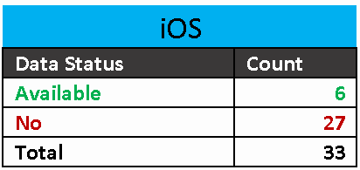
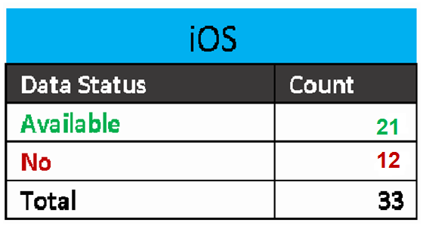
Gap Analysis
GAP Analysis for iOS
a. Analysis using iOS API
b. MS Exchange + API

Slide 16
CIS Setting | Data Available | Using Exchange
1.1.1 Update firmware to latest version | Yes
1.1.2 Enable Passcode Lock | Mostly NO | Yes
1.1.3 Disallow Simple Passcode | No | Yes
1.1.4 Set Auto-lock | No | Yes
1.1.5 Enable Erase Data | No leads | Yes
1.1.6 Forget Wi-Fi networks to prevent automatic rejoin | No
1.1.7 Turn off Ask to Join Networks | No
1.1.8 Turn off Auto-Join for all Wi-Fi networks | No
1.1.9 Turn off Wi-Fi when not needed | Yes
1.1.10 Turn off VPN when not needed | No
1.1.11 Turn off Bluetooth when not needed | Yes
1.1.12 Turn off Personal Hotspot when not needed | Maybe
1.1.13 Turn off Location Services | Yes
1.1.14 Turn on Airplane Mode | Yes
1.1.15 Erase all data before return, recycle, reassignment, or other disposition | ? | ? Same as wipe device ?
1.1.16 Disable View in Lock Screen for apps when device is locked | Maybe
1.2.1 Disable JavaScript | No
1.2.2 Enable Fraud Warning | No
1.2.3 Disable Auto Fill | No
1.2.4 Turn On Private Browsing When Needed | No
2.1.1 Set Security to disallow profile removal | No
2.2.1 Require passcode on device | No | Yes
2.2.2 Require alphanumeric value | No | Yes
2.2.3 Set minimum passcode length | No | Yes
2.2.4 Set Minimum number of complex characters | No | Yes
2.2.5 Set Maximum Auto-lock | No | Yes
2.2.6 Set Maximum number of failed attempts | No | Yes
3.1.1 Enable 'Require password' | No | Yes
3.1.2 Enable 'Require alphanumeric value' | No | Yes
3.1.3 Set the 'minimum password length' | No | Yes
3.1.4 Set the 'minimum number of character sets' | No | Yes
3.1.5 Set the 'timeout' for 'Time without user input before password must be re-entered | No | Yes
3.1.6 Limit the 'Number of failed attempts allowed' | No | Yes

Slide 17
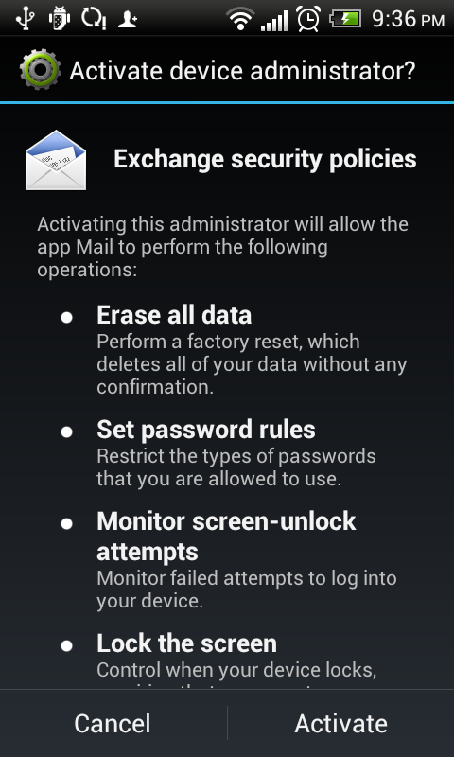
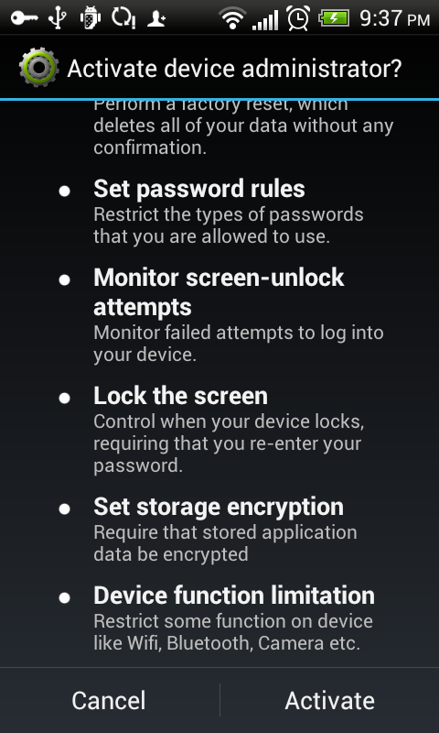
Gap Analysis
Using MS Exchange to collect Data
A policy is created by admin
Only devices that adhere to policy can sync to mail server
User needs to approve of admin rights
Devices settings will be checked only when user decides to sync
Only user is notified of the non compliant settings. How does the admin get to know?(some notification to admin??)
User must allow admin to be activated before the admin can check for settings

Slide 18
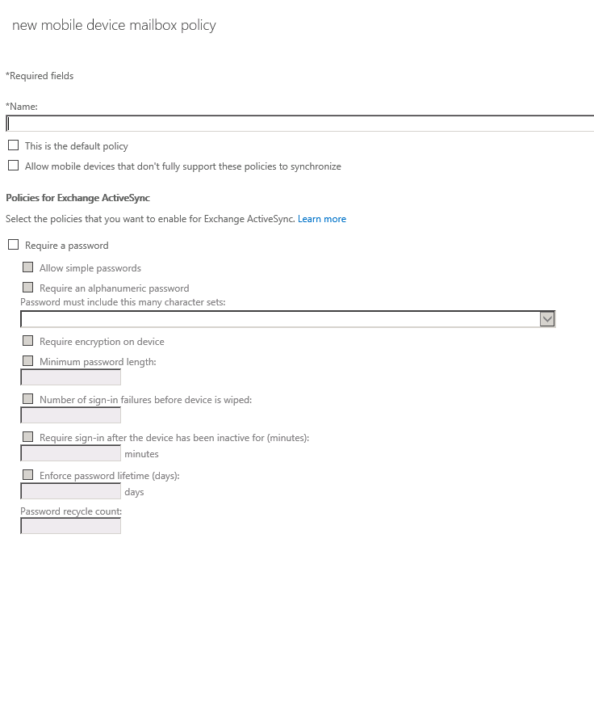
Gap Analysis
Setting a new policy for mobile Device compliance

Slide 19
Push App using
MS Exchange

Slide 20
App Push
Install App?
Only Microsoft apps?
Upload app to MS server?
Push random file?
Public shared folder (host?)

Slide 21
If App is Force Closed

Slide 22
Force Close
Force Close APP on Android:
If the user force closes the app the service gets killed. I had found a post that said using START_STICKY could restart the service automatically. However, START_STICKY does not work if the user force-closes the app. Instead it works when sometimes the android OS kills a background service if it is low on memory. In that case if u use START_STICKY your service will not be chosen by the OS to be killed.
The user however can kill the app even if I use START_STICKY. After that the app is restarted only when the user runs it again.
Force Close APP on iOS:
Force closing an app kills the running service and there is no way of recovering it after that unless the user restarts the app.

Slide 23

Questions?

